Slide 1

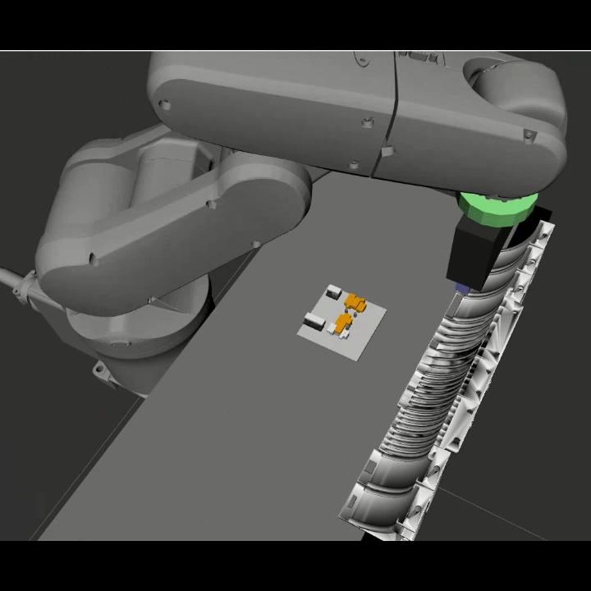
A ROS2-based 3D Block Printer System for Additive Manufacturing with Non-Empirical Stability Analysis
* Saman Diogenes N Cesarino Pedro
Yokohama National University
Yusuke Maeda
Yokohama National University
Notes:
Da o play no vídeo.
I am Pedro Cesarino from Yokohama National University and I will present the work: A ROS2-BASED 3D BLOCK PRINTER SYSTEM FOR ADDITIVE MANUFACTURING WITH NON-EMPIRICAL STABILITY ANALYSIS
Tempo: 0:15

Slide 2
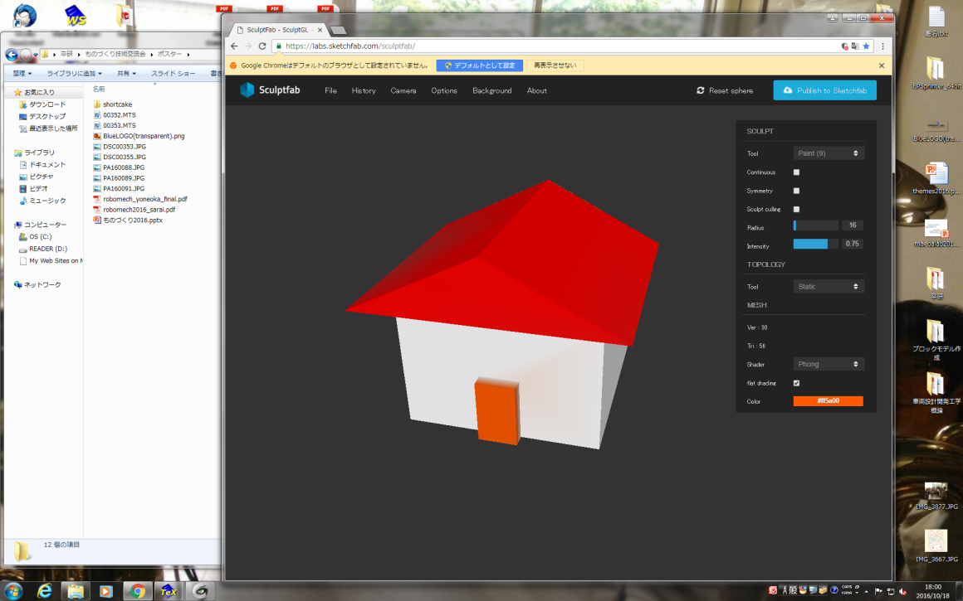
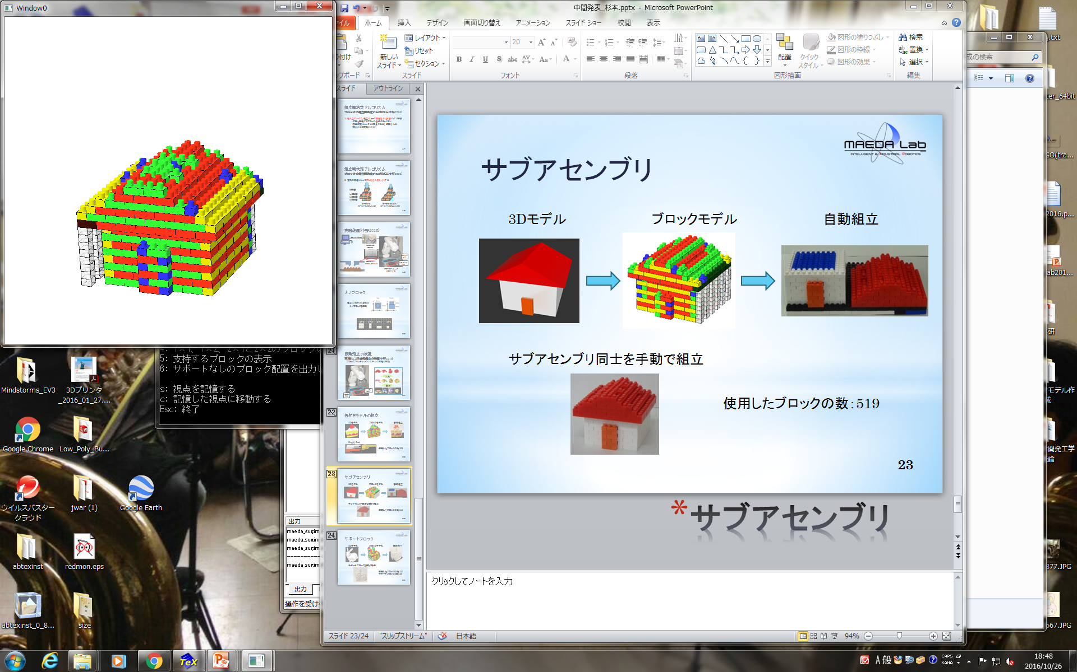
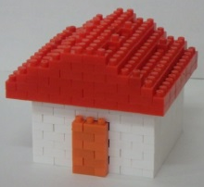
3d Block printing overview
A Robotic 3D block printer that performs additive manufacturing (AM).
A CAD object is used as input and converted to block model using the “Nanoblock” size parameters.
A safe assembly plan is created to guarantee a safe operation while making changes to the block model if necessary.
Assembly is performed first in a simulated environment for validation.
Finally, real assembly is done by an industrial robot.
CAD Model Assembly Plan Visualization Real Assembly
Notes:
It is a…
The system works as follows:
- For example, this house…
- This second image is a visual representation of the safe assembly plan generated.
This is a picture of the assembled structure.
Tempo: 1:05

Slide 3
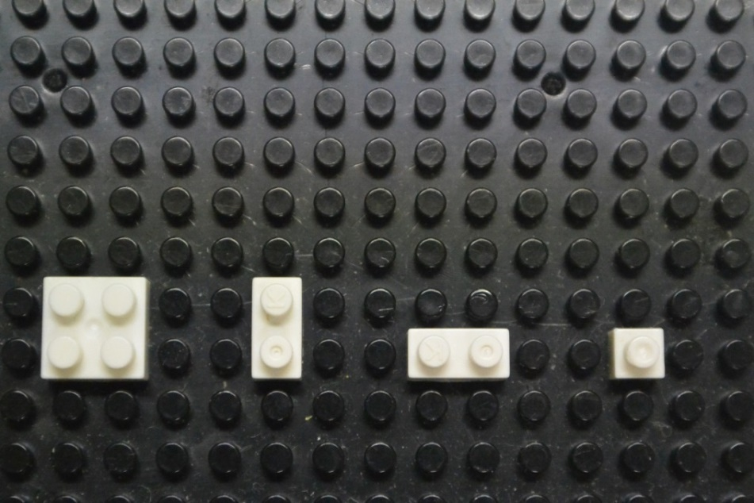

Previous 3d block printer implementation
Utilized empirical approach for safe assembly check [Kohama+ 2020].
Could only simulate and assemble three small block types.
Created in the old and no more updated ROS Kinetic in Ubuntu 16.04.
2×2 2×1 1×1
Notes:
- Our previous 3D block printer utilized…
For example, in this image it is illustrated one of the empirical rules. If there were no connection between the inserted block here and the ground via other blocks as illustrated by the blue dashed line, it would be deemed unstable.
- Because of this empirical approach It could only…
- Only the 3 smallest blocks were usable.
Tempo: 1:45

Slide 4
related studies
[Sekijima+ 2015] proposed the “Kelvin Block” and [Suzuki+ 2018] the “Dynablock”. Both could be connected to each other by magnetic force.
Relied on using an original building blocks that required magnetic interaction.
They did not consider mechanical stability of the structure during operation.
[Luo+ 2015] and [Hong+ 2016] tackled the construction and optimization of LEGO models focusing on generation of the sculptures.
Did not consider the automatic assembly impact in stability.
Notes:
- Some related studies tackled the block printing problem…
For example, Sekijima…
But they relied …
Also, they did not…
Luo and …
But they did …
Tempo: 2:25

Slide 5
Objective
Finish the physics-based assembly planner developed in [Maeda+ 2019] and [Cesarino+ 2022].
Create a new robot motion control system using modern tools like ROS2 that calculates the joints trajectory to perform block picking and placing.
Create a new environment to simulate the robotic assembly process.
Execute the safe and non-empirical assembly plan using wider variety of blocks in the real setup.
Notes:
The objective of this work was to:
…Maeda and Cesarino to substitute the previous empirical stability judge.
Tempo: 3:10

Slide 6
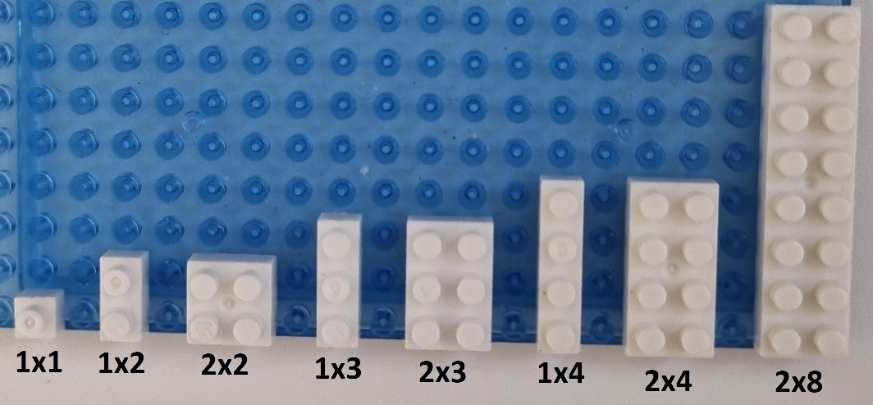
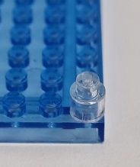
Building blocks
“Nanoblocks” are utilized as building blocks.
All blocks have a cavity space and a stud where it can connect with other blocks.
All rectangular shapes are now usable.
Support blocks are cylindrical and transparent.
2.5 mm
2.0 mm
4.0 mm
2.5 mm
3.0 mm
4.0 mm
4.0 mm
1 by 1 block type dimensions
Available block types Support block
Notes:
Nanoblocks by Kawada company are…
…
Here we have the 1 by 1 block dimensions. Two blocks are connected when the lower block stud is inserted in the upper block cavity. Blocks stick together due the friction force in this contact area.
With the development of the new assembly planner, all …
These one are the ones currently available in our lab. Although every rectangular shaped block could be used in theory.
There are also the support blocks that are cylindrical and transparent to standout during assembly.
Tempo: 4:00

Slide 7
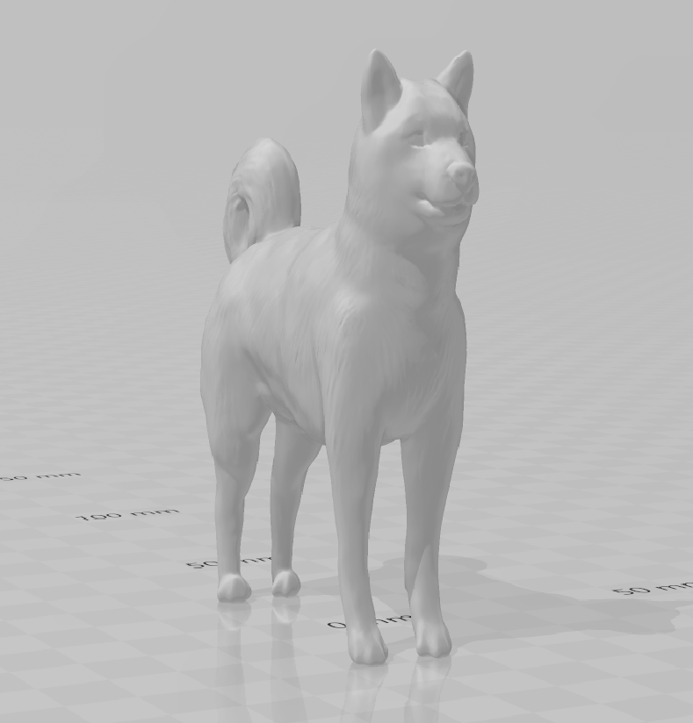
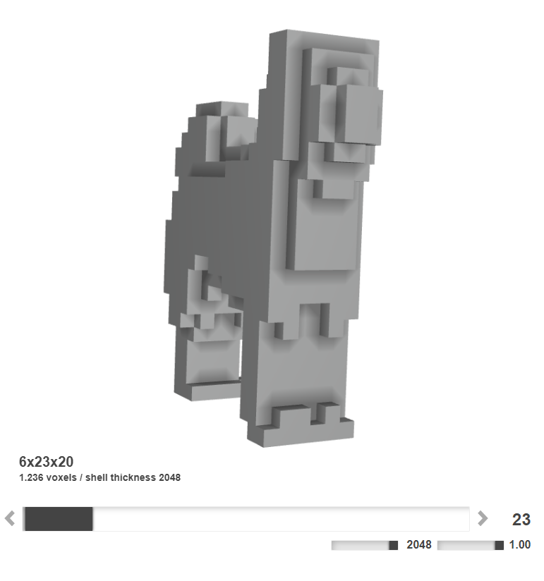
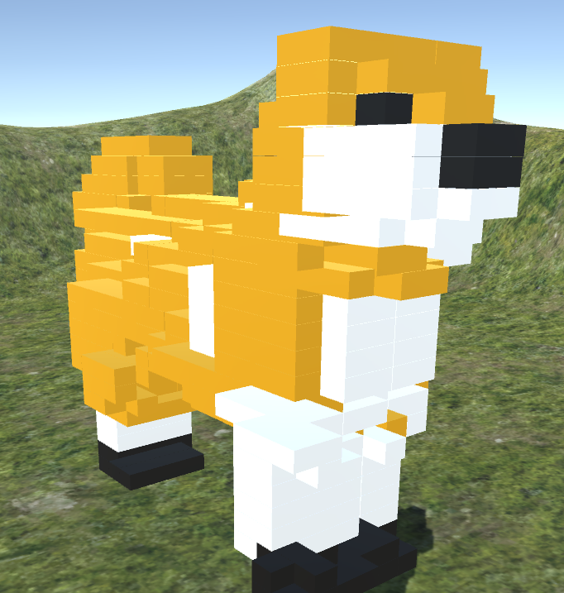
FROM CAD TO BLOCK MODEL
A web service transform the CAD object to voxel representation. *
An algorithm fills each layer with a good set of blocks that fills exactly the voxel model shape.
Necessary to add color to blocks manually.
CAD model Voxel model Initial Block Model
* https://drububu.com/miscellaneous/voxelizer/?out=obj
Notes:
The first step in the workflow is to convert the CAD model to voxel representation (show in the image). This is done by using a free webservice.
A voxel model can be seen as a minimum block representation, so it needs to be converted to the available block types shape.
So an algorithm …
It is necessary …
Here we have the CAD model converted to block model using the nanoblocks as building blocks
Tempo: 4:45

Slide 8
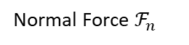
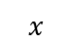
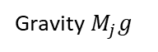
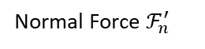
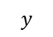
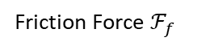
Assembly planning (1/3)
The assembly planner decides a block insertion order that guarantees a safe assembly.
Checks stability for every single block insertion.
Handles the cases where stability can not be assured.
Determines every force location for all blocks in each assembly step.
Friction Force $ℱ_{f}$
Normal Force $ℱ_{n}^{′}$
Normal Force $ℱ_{n}$
$$y$$
Gravity $M_{j}g$
Pushing Force
$$x$$
Top view
Front view
Notes:
Once an initial block model is generated, the assembly…
…
In this figure we can see the defined force model. In this example those are all the possible forces that can appear in a 2 by 2 block being friction and normal forces in the studs when a connection exists, the contact normal forces in the edges when a block in placed above and the gravity force. And here is how the insertion force is defined when a 1 by 1 block is being inserted.
Tempo: 5:45

Slide 9
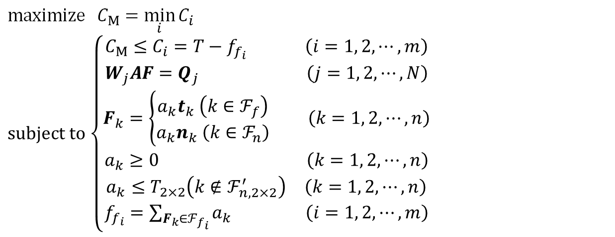
Assembly planning (2/3)
Capacity [Luo+ 2015] is utilized as stability metric.
It is calculated for every single block connection as: the difference between the maximum static friction force defined and the resultant force calculated.
A linear programing problem is defined to search for a distribution of forces that maximizes the minimum capacity in the entire structure.
$\text{maximize} C_{M}$ $=\min_{i}{C_{i}}$
$\text{subject} \text{to}$ $\left\{\begin{aligned}\begin{matrix}C_{M}≤C_{i}=T−f_{f_{i}} \left(i=1, 2, ⋯,m\right) \\ W_{j}AF=Q_{j} \left(j=1, 2, ⋯,N\right)\end{matrix} \\ F_{k}=\left\{\begin{aligned}a_{k}t_{k} \left(k∈ℱ_{f}\right) \\ a_{k}n_{k} \left(k∈ℱ_{n}\right)\end{aligned}\right. \left(k=1, 2, ⋯,n\right) \\ \begin{matrix}a_{k}≥0 & \left(k=1, 2, ⋯,n\right)\end{matrix} \\ \begin{matrix}a_{k}≤T_{2×2}\left(k∉{\text{ℱ}}_{n,2×2}^{′}\right) & \left(k=1, 2, ⋯,n\right)\end{matrix} \\ f_{f_{i}}=\sum_{F_{k}∈ℱ_{f_{i}}}{a_{k}} \left(i=1, 2, ⋯,m\right)\end{aligned}\right.$
Notes:
The stability metric utilized is called Capacity and was defined by Luo+ in their research. Although in their work, they did not consider the block insertion when calculating connection stability.
…
…
This are the equations that defines the optimization problem.
Here we have CM as the minimum capacity in the structure. Which is equal the to maximum friction force defined before the block connection break minus the forces calculated to be acting in there.
Tempo: 6:40

Slide 10
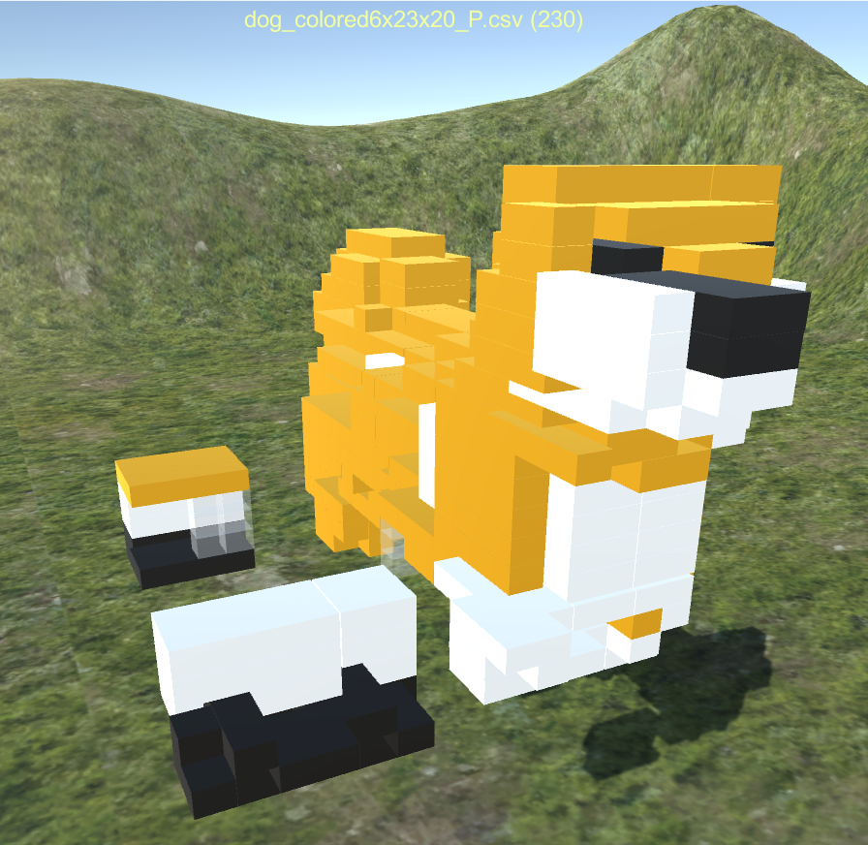
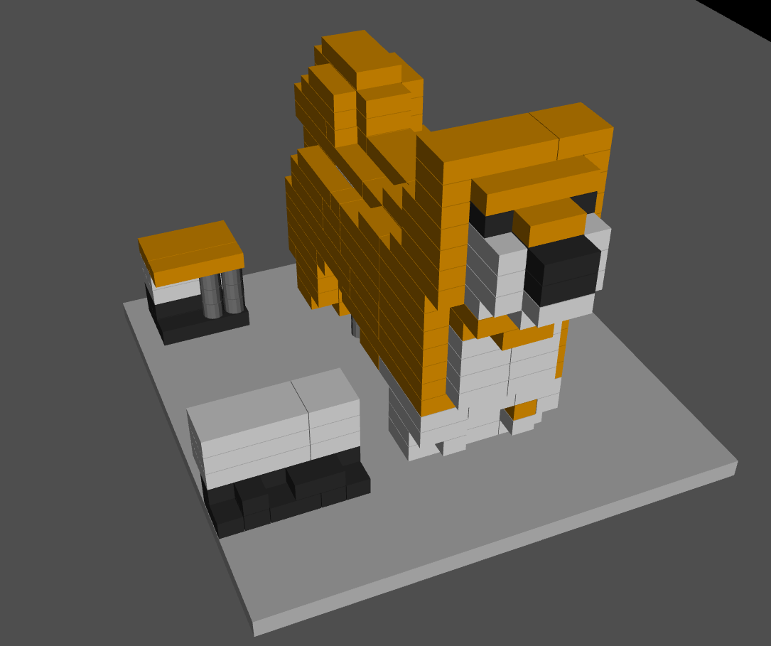
Assembly planning (3/3)
Positive Cm: every block connection can handle the insertion of the new block.
Negative Cm: necessary friction force to guarantee the static condition is greater than the maximum possible.
Unstable insertions can be avoided by performing stabilizing strategies.
Initial Block Model Assembly Plan Visualization Assembly Simulation
Notes:
If the minimum capacity found by the optimization algorithm is positive …
But, if negative…
Here we have the Initial block model and the visualization of the safe assembly plan.
Tempo: 7:05

Slide 11
Stabilizing strategies (1/2)
There are three possible strategies if a block is deemed unsafe for insertion.
Place A before B
Place B before A
A
B
A
B
Insertion order change
Notes:
A little more about the strategies the assembly planner can take when an unstable insertion is detected.
The first one is Insertion Order Change.
Sometimes changing the block insertion order is enough to guarantee stability. Here if Block A is placed before block B in this position, the insertion force could snap out the orange block.
But if it is decided to place B first, the internal forces between block B and the orange and green blocks could be enough to hold the structure together when placing block A.
Tempo: 7:45

Slide 12
Stabilizing strategies (2/3)
Sometimes no insertion order can guarantee stability.
Support block strategy
Subassembly strategy
Notes:
…
In this example the red block has no contact points below. So it is impossible to the robot to insert it in this position.
In such cases this two strategies can be performed.
In the support block strategy, columns of support blocks can be added to the model to stabilize the structure.
Or else, in the same example case a subassembly strategy could be performed dividing the assembly into two or more making possible the assembled by a robot.
Tempo: 8:20

Slide 13
ROBOTIC CONTROL SYSTEM
It is necessary to execute the assembly plan generated.
As the robotic manipulation platform, it was used MoveIt2 running with ROS2.
Manipulation Task Constructor (MTC) framework was utilized to create the robot joint trajectory.
MTC calculates the best joint trajectory to pick the blocks in the blocks feeder and place them it in the correct position and orientation while avoiding collision.
Notes:
A robotic control system is necessary…
…
…
…
…avoiding collision between the robot links themselves, with the setup and the sculpture being assembled.
Tempo 9:00

Slide 14
Assembly simulation
Notes:
Play no video
A new simulated environment was created using RViz2 to test and verify the new physics-based assembly planning.
Now it is possible to simulate the assembly utilizing the wider variety of block sizes.
Here we can see the robot performing assembly following the safe assembly plan. For practical implementation, the gripper does not move and do not touch the block during simulation. Gripper commands and force sensing for block insertion will be implemented when performing the real assembly process.
For simplification in this simulation, the blocks feeder only displays one color for each type. The color being corrected in the moment the manipulator moves to pick it up.
Tempo: 09:50

Slide 15
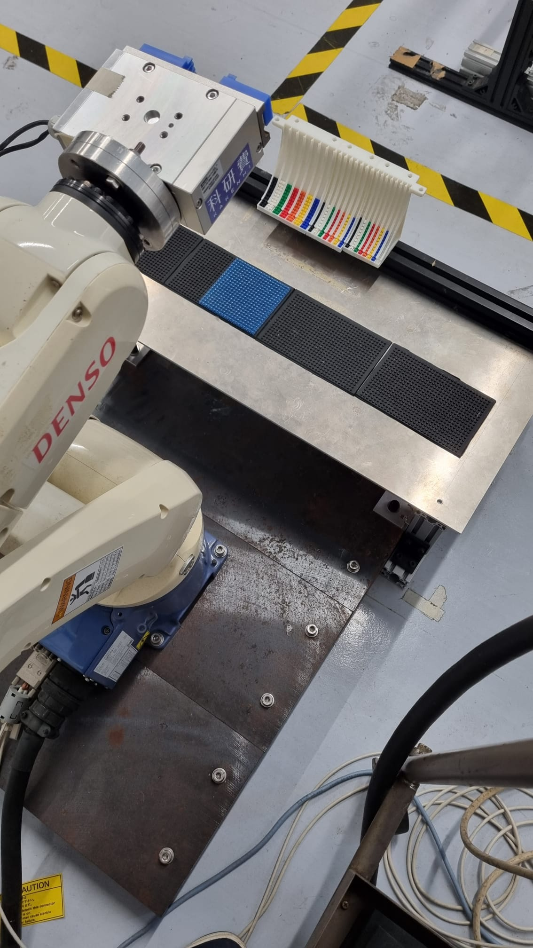
Physical Setup
Robot: Denso Wave VP6242.
Controller: RC7M.
Gripper: Taiyo DRH-ESG1.
Blocks feeder for each block type and color.
Assembly base.
Notes:
- In the physical setup we decided to use the…
…
…
…
Here we have some blocks feeders that were created in a slide shape for each block type and color to automatically refill a block and one is pick up.
And an assembly base where the sculpture is assembled.
Tempo: 10:25

Slide 16
Conclusion
The assembly planner with physics-based stability analysis and capability to stabilize unstable block models utilizing a vast array of block types was finished.
The robot motion control system was created using ROS2 and MoveIt2 to generate joints trajectory to execute the assembly plan.
The virtual assembly setup was created, and the assembly process simulation was achieved.
The physical setup was recreated.
Notes:
- Finally, Conclusion.
…
Unfortunately, the physical assembly process is not yet complete to perform assembly with the new non-empirical stability judge and new block types.
Tempo: 10:55

Slide 17
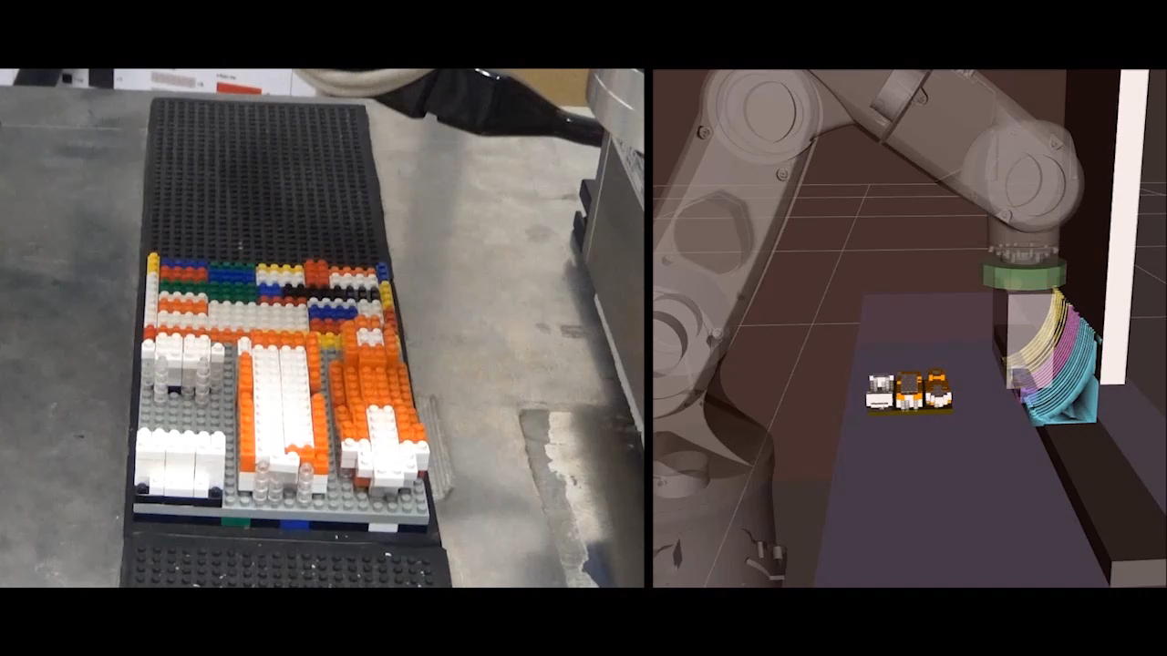
Next Steps
Fabricate and position the missing blocks feeders for the bigger block types in the setup.
Adapt the robot control system to utilize the real robot instead of the simulated one.
Improve the stabilizing strategies to search for better assembly plans.
Notes:
- Future work.
- This video is a demonstration of our previous block printer performing assembly in the real setup.
As future work it is still necessary to …
…
…
The objective is to achieve real assembly, as in this video, but now utilizing the new assembly planner and all the new possible block sizes in the updated physical setup.
…
To finally be able to utilize the new 3D block printer from the first stage of choosing a CAD model all the way to fabricate it in the real world utilizing all the improvements presented in this work.
Tempo: 11:55

Slide 18
Thank you for your kind attention

Slide 19
Block Assembly simulation (1/2)
A simulated environment was created using RViz2 to test and verify the assembly process.
An assembly setup was created to closely represent the real one planned to be used.
Assembly Plan Visualization Assembly Simulation
Notes:
- A simulated …
…
The first image is just the assembly plan visualization and the second one is a picture of the final output of the simulated assembly process.
Tempo: 9:35

Slide 20
Place A before B
Place B before A
A
B
A
B

Slide 22
Friction Force $ℱ_{f}$
Normal Force $ℱ_{n}^{′}$
Normal Force $ℱ_{n}$
$$y$$
Gravity $M_{j}g$
$$x$$
Pushing Force
Top view
Front view

Slide 23
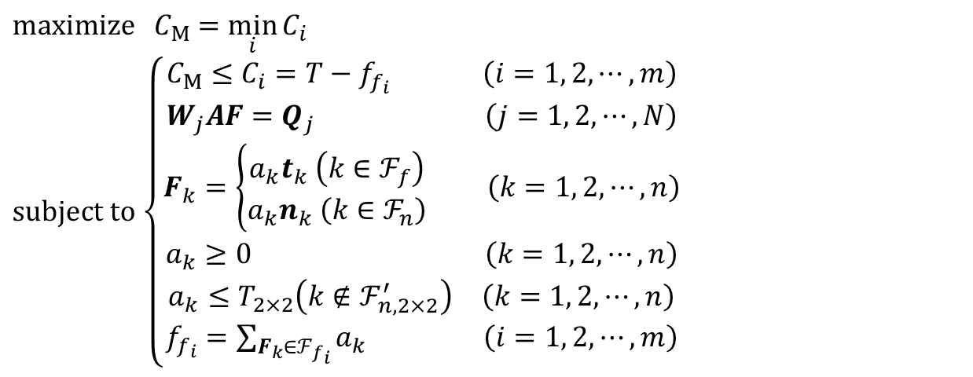
$\text{maximize} C_{M}$ $=\min_{i}{C_{i}}$
$\text{subject} \text{to}$ $\left\{\begin{aligned}\begin{matrix}C_{M}≤C_{i}=T−f_{f_{i}} \left(i=1, 2, ⋯,m\right) \\ W_{j}AF=Q_{j} \left(j=1, 2, ⋯,N\right)\end{matrix} \\ F_{k}=\left\{\begin{aligned}a_{k}t_{k} \left(k∈ℱ_{f}\right) \\ a_{k}n_{k} \left(k∈ℱ_{n}\right)\end{aligned}\right. \left(k=1, 2, ⋯,n\right) \\ \begin{matrix}a_{k}≥0 & \left(k=1, 2, ⋯,n\right)\end{matrix} \\ \begin{matrix}a_{k}≤T_{2×2}\left(k∉{\text{ℱ}}_{n,2×2}^{′}\right) & \left(k=1, 2, ⋯,n\right)\end{matrix} \\ f_{f_{i}}=\sum_{F_{k}∈ℱ_{f_{i}}}{a_{k}} \left(i=1, 2, ⋯,m\right)\end{aligned}\right.$

Slide 24
